Slide 1
REGEX
Training in R

Slide 2
PRESENTATION DAY 1

Slide 3
What is REGEX?
“REGEX” is a shortened way of referring to a “Regular Expression”.
Regular expressions are a sequence of characters that define a search pattern.
Think of it like a game of “I Spy” or “20 Questions”.
You are not showing the computer exactly what you want to find,
but rather describing it.

Slide 4
Why REGEX?
There are many situations in which you would want to describe and find a search pattern within a dataframe or text string:
Flag mentions of certain terms within survey or patient record data
How many surveyed individuals mentioned swimming in a pool, lake, pond, or the ocean?
How many surveyed individuals mention having a pet of some kind?
Group similar records by creating simplified identifier
Giving street addresses a consistent format can allow for better grouping of repeat locations
Matching phone numbers that might have different parentheses, spaces, or dashes within them.
Subset a string for only matched text
Look at a long DNA sequence and pull out every gene that matches certain criteria
Pull out and save a list of email addresses from a messy collection of employee information
And more!

Slide 5
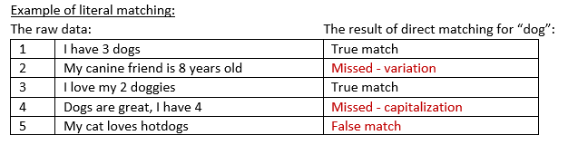
REGEX is not direct, literal matching
Well, not only literal matching.
A very simple string such as “banana” can be used as a regular expression search, but what are the drawbacks?
You will only find EXACT matches, no room for error and no flexibility
You must be confident that you know of every exact term you need to find. This means you may spend a large amount of time looking through the records and collecting terms to search for, or writing out all possible spellings/misspellings.
Multiple searches may have to be run to account for different items.
Example of literal matching:
See the need for a better description of what we are looking for?
Again, think of this as a game of 20 Questions, where you have only one piece of info so far – that you want to find “dog”.
What other info might we be able to give to help include or exclude various records?

Slide 6
REGEX is not “fuzzy” matching
“Fuzzy” matching in R is done by finding matches that do not 100% line up.
This type of matching often makes use of REGEX patterns, but the “fuzzy” part itself refers to the allowance for imperfect matches.
When fuzzy matching, we might instruct the computer to find matches to “banana” that are 80% correct
This can be done using agrep( pattern, text, max.distance ) in R, and setting the max.distance to 20% (0.2)
The distance you choose depends on your expected variation and your tolerance for false positives.
agrep("banana", c("banana", "bannana", "bananna", "bnaana"), max.distance = 0.2)
The result is the indices of the matches: 1, 2, 3, and 4 - all matched at 80%

Slide 7
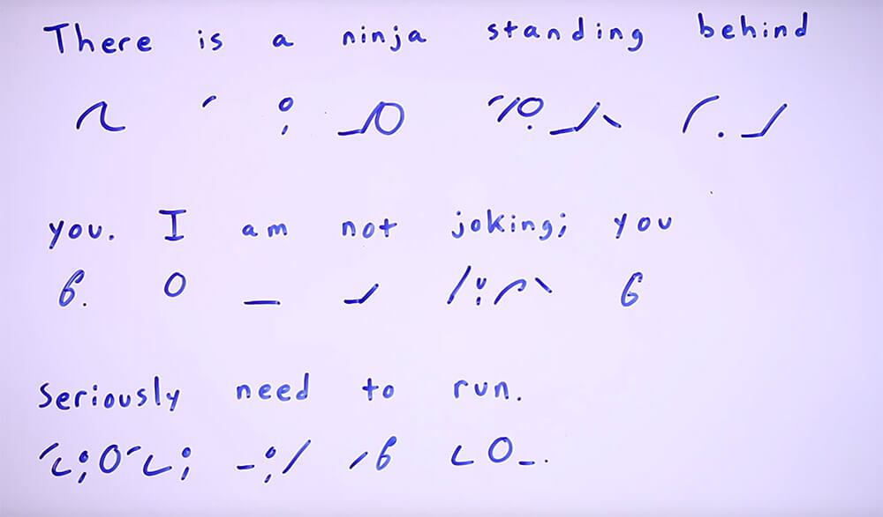
What is REGEX made of?
REGEX patterns are made up of
Characters – ABC, 123, etc
Character classes – Digits, Alphanumeric, Letters, etc
Metacharacters – newline, tab, etc
Lookarounds – what is near it: “match if not followed by…”
Groups – use () to separate sections of the pattern: (this subpattern) or (that subpattern). Use [] to list a group of permitted characters.
Anchors – start of the string, end of the string, beginning of word, etc
Escapes – enable the use of a code/REGEX symbol as its literal self: “+” is a quantifier. “\\+” escapes it to be used as a literal plus sign
Quantifiers – number of times the previous thing needs to occur in the match: if a group in (), everything in there. Otherwise, the previous one item.
Take a look at this cheat sheet to see the different pieces:
https://rstudio.com/wp-content/uploads/2016/09/RegExCheatsheet.pdf
This means that
**Your REGEX pattern will most likely not look like words or a sentence**
Think of it like a type of shorthand containing descriptions.

Slide 8
A few ways to use REGEX in R
grep() will return a vector of the indices of the elements that yielded a match
This is part of base R
The format is: grep(pattern, strings, options)
agrep() will return a vector with the indices of each fuzzy match, or use value=TRUE option to return the matched element itself.
This is part of base R
The format is: agrep(pattern, strings, max.distance, options)
agrepl() will return a logical vector (see grep() vs grepl).
grepl() will return a vector of TRUE/FALSE the same length as the the input data. TRUE means a match was found.
This is part of base R
The format is: grepl(pattern, strings, options)
str_detect() will return a vector of TRUE/FALSE the same length as the the input data. TRUE means a match was found.
This requires the stringr package
The format is: str_detect(strings, pattern, options)
str_match() will return the portion of the text which matched the pattern if a match is found, else NA. The result is a character matrix made up of
ONLY the matched part of the full text. First column is the complete match, followed by one column for each capture group.
This requires the stringr package
The format is: str_match(strings, pattern)
strapply() will apply a function over the matched items and return them as a list of character vectors
This requires the gsubfn package
The format is: strapply(strings, pattern, function)
gsub() will replace the text that matches your pattern and return your input in the same format it was passed as.
This is part of base R
The format is: gsub(pattern, replacement, strings)

Slide 9
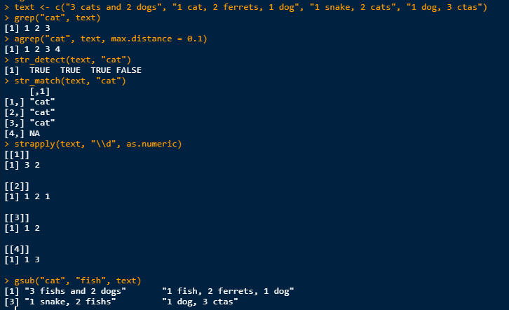
Examples
Our text has 4 strings which are answers to a survey question about pets:
“3 cats and 2 dogs”
“1 cat, 2 ferrets, 1 dog”
“1 snake, 2 cats”
“1 dog, 3 ctas”
Let’s use the simple pattern
“cat” to demonstrate the use
of these functions:
*Next time, we can review how to use these output types in more detail

Slide 10
How to set up a REGEX
It can be helpful to write out what you want to say in English first. Let’s think about our “dog” example again.
Ideally, we want to tell the computer to do the following:
“Find the text ‘dog’, where the word starts with ‘dog’ and ends in either g, gs, or ggies. Also consider ‘canine’ to be a match.”
“dog” text
Word begins with dog (not the ending of some other word like “hotdog”
Ends in g, gs, or ggies (dog, dogs, doggies)
“canine” or “canines” would also be a match

Slide 11
Let’s build our REGEX
Start with the simple root
dog
What does it say?
must match exactly “dog”
2. Add the variations:
Looking at our cheat sheet, we can see that the pipe “|” is used to say “or”
We should encapsulate the things that the “or” is comparing in parenthesis so that the pipe knows how long each phrase is. (compare “dog” and “canine”, not just the “g” and “c”)
(dog)|(canine)
What does it say?
must match exactly “dog” or “canine”

Slide 12
Let’s build our REGEX
3. Add optional endings:
Using [ ] we can specify multiple options as a subset. By adding a quantifier we can specify how many times we want them to appear – in this case at least one time for g, gs, or ggies, and at least zero times and at most 1 time for the s after “canine” – since it is ok to not have an s.
Everything within parentheses is a subset, and the pipe “|” between them shows that any of the options is ok: ( this | that )
Square brackets contain a list of permitted characters
? means “at least zero, at most 1”
{ } brackets like this contain the number of occurrences allowed, and can be a range {0,1}
(do(g|gs|ggies){1})|(canine[s]?)
What does it say?
match “do” with one ending of “g”, “gs”, or “ggies”. Or match “canine”, which might end in an “s”.

Slide 13
Let’s build our REGEX
4. Make it be the beginning of a word, not within a larger word.
By adding an anchor “\\<” we can avoid matching words that contain “dog” – like “hotdog”
Since this anchors the beginning of our string to the letter “d”, the entire phrase is anchored as well.
(\\<do(g|gs|ggies){1})|(canine[s]?)
What does it say?
match a word starting with “do” with one ending of “g”, “gs”, or “ggies”. Or match “canine”, which might end in an “s”.

Slide 14

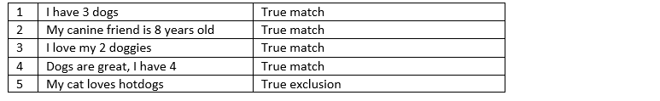
Let’s build our REGEX
5. When searching, use the option ignore.case = TRUE to ignore capitalizations.
grepl(“(\\<do(g|gs|ggies){1})|(canine[s]?)”, data, ignore.case=TRUE)
How does this compare to our original goal?
match a word starting with “do” with one ending of “g”, “gs”, or “ggies”. Or match “canine”, which might end in an “s”.
“dog” text
Word begins with dog (not the ending of some other word like “hotdog”
Ends in g, gs, or ggies (dog, dogs, doggies)
“canine” or “canines” would also be a match
Now we can try to match our data again:
GREAT!

Slide 15
How to test REGEX when writing it
Our REGEX for dogs worked great, but what if it didn’t? How do we test this without iterating over the entire dataset?
When testing REGEX, try some example text against your pattern to look for possible mistakes or the need for more description
For example, instead of matching against all the records, we can test just a few words:
I want to see if my pattern for addresses will catch all the “100 Mack Avenue” locations
I set up a list of what I expect to need for variations:
Those with capitalized letters
East being included
Ave being spelled as “Ave”, “Ave.”, “Avenue”, or not present
Etc
I test my pattern against these simple examples and look to see if I get any false positives or negatives:
pattern <- [the current pattern you are testing here]
testData <- c(“100 Mack”, “100 Mack Ave.”, “100 Mack Avenue”, “100 Mack Ave”,
“100 mack”, “100 East Mack”, “100 E. Mack Ave”,
“100 E Mack Avenue”)
grepl( pattern, testData, ignore.case = TRUE)
Next, I will also make a random subset of my data with 10-100 rows and check for weird match situations
What are some of the benefits of testing this way?
Identify issues clearly by seeing which items failed
Save processing time if your dataset is large
Remove noise of surrounding text that might be present in your data, to focus only on the part you are trying to match
Make you think through the possible options and improve your pattern by realizing other variations

Slide 16
Homework! Yay!
Take the example dataset and create the following REGEX patterns:
Find rows that mention a location of 100 Mack Avenue
Find rows that mention a pet cat
Write down what the pieces of your REGEX mean and why you chose them
Use the cheat sheet and Google!
Write down any confusing parts or questions
Next time, we will:
review common mistakes
answer questions!

Slide 17
Resources
Watch these two videos for an in depth overview!
https://www.youtube.com/watch?v=NvHjYOilOf8
https://www.youtube.com/watch?v=q8SzNKib5-4
Check out this article for more on using stringr:
https://www.linkedin.com/pulse/tying-all-together-stringr-samantha-bell/
Refer to this tutorial for expanded info on REGEX usage in R:
https://bookdown.org/rdpeng/rprogdatascience/regular-expressions.html

Slide 18
PRESENTATION DAY 2

Slide 19
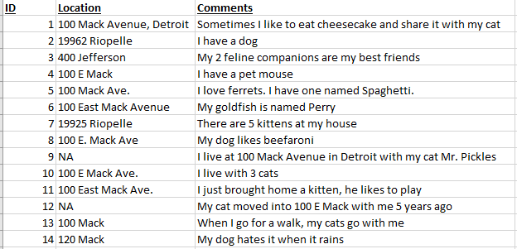
Let’s review the homework dataset
Made up of:
Patient record ID
Residence address
Free text answer to an open-ended pet survey question

Slide 20
What might we notice as issues?
Some missing addresses
Address could be hidden in the free text
No set structure to the pet information

Slide 21
Homework Question – Part 1
Find rows that mention a location of 100 Mack Avenue.
Look at potential variation styles
East, E., E
Ave, Avenue, or no street type
In Location or Comment column
Think about future flexibility
Variation in capitalization
Longer street numbers that include “100”
Do we expect misspelling to be an issue?

Slide 22
Homework Solution – Part 1
Some solutions for the pattern:
\\<100.(e|east)?.{0,2}mack
Anchors the beginning so that we will not match numbers such as “1100”
A space or any character 1 time
“e” or “east” characters, may or may not be present
1 space or any character up to 2 times (allows for a space & a period)
“mack”
\\<100\\s(e.{0,4})?mack
Anchors the beginning so that we will not match numbers such as “1100”
A space 1 time
“e” followed by 0 to 4 of any character – allows for “e”, “east”, or “e.”. May or may not be present
“mack”
3. \\<100[[:space:]](e|east|e\\.)?[[:space:]]?mack
Anchors the beginning so that we will not match numbers such as “1100”
A space 1 time
“e” “east”, or “e.” (note the escaped period). May or may not be present
A space may or may not be present
“mack”
There are many right answers!

Slide 23




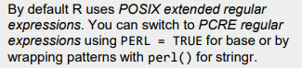
Homework Errors – Part 1
What is wrong here?
100 mack|100.{,10} mack
Does it work for our small dataset?
Would it allow for future flexibility with a larger sample size?
Longer street numbers – could falsely extra numbers at beginning or end
Is there too much leeway given to any piece?
Weigh the pros and cons of allowing 10 characters to follow the “100”. What happens if there is an address of “1000 mack”?
Are there repeated elements that could be combined?
Any pieces that will always stay the same should not appear more than once in the pattern
Let’s clean it up:
\\<100.{,10}.mack
The second side of the pipe was accomplishing the same as the first, only with more flexibility. We can just use that alone if we are ok allowing up to 10 of ANY characters in the middle. (Again think about what happens if there is an address of “1000 mack” or more)
Anchor it
*Important note about spaces:
In R REGEX it allows you to leave a literal space “ ”. But best practice is to use a symbol:
[[:blank:]] = Space and tab
[[:space:]] or \\s = Space, tab, vertical tab, newline, form feed, carriage return
. = Any character except \n

Slide 24

Homework Errors – Part 1
What is wrong here?
100.{0,6}Mack.{0,4}Avenue|100.{0,6}Mack
Does it work for our small dataset?
Would it allow for future flexibility with a larger sample size?
Longer street numbers
Is there too much leeway given to any piece?
Weigh the pros and cons of allowing 6 characters to follow the “100”. What happens if there is an address of “1000 mack”?
Is any part to strict?
Weigh the pros and cons of requiring “Avenue” in one option
Why do we need this? Is there something we would falsely match if we did not include it?
Are we excluding “Ave”?
Less is more. Don’t include text if you don’t need to be that specific
Are there elements that override each other?
If we allow “100.{0,6}Mack”, this will take care of any strings that contain the same thing followed by “Avenue”, “Ave’, etc
(No need for both, one is not used.)
A greedy or flexible piece of any “or” statement will always override a more stringent one
Let’s clean it up:
\\<100.{0,6}Mack
The second side of the pipe was accomplishing the same as the first, only with more flexibility.
The 6 character allowance will allow for up to 2 spaces and the word “East”, but also allow any other characters, so consider the risks.
Anchor it

Slide 25
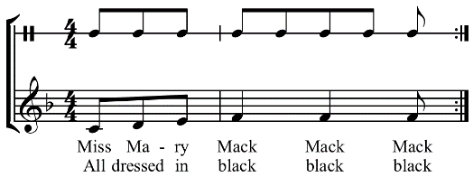

Don’t be too greedy
Be cautious when using the greedy quantifier “*” or high numbers in {0,#} \\<100.*(e|east)?.{0,2}mack
This would work, but allows for 0-infinity number of characters between “100” and “mack”
The same as writing \\<100.*mack
It looks nice and short and clean, but would this work for our situation?
With the small dataset we have, yes
Pro is that it could allow for apartment numbers in between street number and name
Consider the types of fields we are matching
Comment fields are messy and can be more dangerous to allow for greedy matching
What might we accidentally match?
\\<100.*mack would return TRUE for long strings of text such as, “100 times my sister and I sang Miss Mary Mack.”
Would also return TRUE for longer numbers like “10095 Mack”
Think about what risks there are with being greedy, how likely they are, and if it is worth doing so.
\\<100.{0,100}(e|east)?.{0,2}mack
Would problematically match longer street numbers such as “10362 Mack”
Would allow for any other text in between 100 and Mack, up to 100 characters
Get in the habit of thinking through the pros and cons of your decisions: Balance the false negatives and false positives.

Slide 26
Homework – Part 2
Find rows that mention a pet cat.
Look at potential variation styles
Cat, cats, kitten, feline
All seem to be in Comments column
Think about future flexibility
Variation in capitalization
Other ways we might refer to cats?
Extreme would be breed names alone:
“I own 2 Siamese.”
Weigh the necessity of capturing these

Slide 27
Homework Errors – Part 2
Tell me what is wrong here:
pet.{0,4}cat|cat|feline.{0,4}companion|kitten
Extra
1. Why include “pet”?
It only goes along with “pet cat” in this pattern
Too specific to the small dataset we have
If we match “cat”, we already are matching anything with “pet cat”, and so this is overridden
Too strict
Why include “companion”?
It is tied to “feline” in this pattern
Again very specific to this small dataset
Does not allow for a match of “feline” alone, requires “feline companion”
Don’t write your pattern to only match what you already know is there – be open to new possibilities
Let’s clean it up:
\\<cat|feline|kitt(en|ies)
Simplest version of each unique form
Allows for plurals to be matched, since they contain the singular
Thinking forward: what if there are other versions such as “kitties”? What about other words containing “cat”?

Slide 28
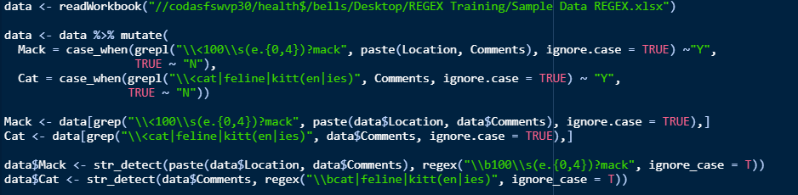
Homework Applications
There are many right answers!
How can we use these patterns to flag our records?
Mutate + grepl
grepl gives you a TRUE/FALSE vector, which we use to make “Y” or “N”
2. Make subsets using grep
grep returns the index of the match. Use the indices to subset:
data[(row indices), ]

Slide 29

Other Questions
Could you search over the entire dataframe at once?
SURE! If you know you want to consider all columns, you can concatentate them and match to the entire row at once:
This says apply the paste function over the dataframe by rows(1), collapsing with a space in between.
What about str_detect?
Let’s answer the homework by directly adding a new column using str_detect
str_detect returns a TRUE/FALSE vector
We can ignore case in stringr by wrapping our REGEX in regex(), and including the option ignore_case = T within that wrapper.
str_detect(data, regex(“pattern”, ignore_case = T))
This is a special case because the stringr package doesn’t like our word anchor “\\<”
– Instead we will use the word boundary “\\b”
This stands for “empty string at either edge of a word”
How else might we make use of boundaries? What about the other end of our street number?
Think about how this emphasizes the need to test our patterns with the commands we are going to use.
These are the same

Slide 30

Shout out
Bonus points to Chibz for thoroughly writing down her thought process and for including test data in her code!
As you are learning:
Write everything out in plain English. Then VERIFY.
Leave your future self lots of nice comments.
Test. Test. Test.

Slide 31
Next time
We will:
Look at some of the different ways to use REGEX in R, and how to manipulate the output types
Send me any REGEX questions you have so far, and I will cover them in the subsequent lessons!

Slide 32
PRESENTATION DAY 3

Slide 33
REGEX application
Let’s take a look at some of the functions we mentioned before:
(search documentation here: https://www.rdocumentation.org/packages/base/versions/3.6.2)
grep() will return a vector of the indices of the elements that yielded a match
This is part of base R
The format is: grep(pattern, strings, options)
agrep() will return a vector with the indices of each fuzzy match, or use value=TRUE option to return the matched element itself.
This is part of base R
The format is: agrep(pattern, strings, max.distance, options)
agrepl() will return a logical vector (see grep() vs grepl).
grepl() will return a vector of TRUE/FALSE the same length as the the input data. TRUE means a match was found.
This is part of base R
The format is: grepl(pattern, strings, options)
str_detect() will return a vector of TRUE/FALSE the same length as the the input data. TRUE means a match was found.
This requires the stringr package
The format is: str_detect(strings, pattern, options)
str_match() will return the portion of the text which matched the pattern if a match is found, else NA. The result is a character matrix made up of
ONLY the matched part of the full text. First column is the complete match, followed by one column for each capture group.
This requires the stringr package
The format is: str_match(strings, pattern)
strapply() will apply a function over the matched items and return them as a list of character vectors
This requires the gsubfn package
The format is: strapply(strings, pattern, function)
gsub() will replace the text that matches your pattern and return your input in the same format it was passed as.
This is part of base R
The format is: gsub(pattern, replacement, strings)

Slide 34
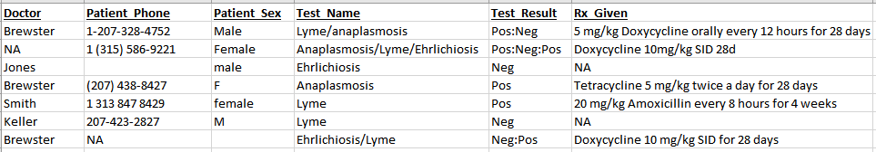
Our sample data
We have some patient data related to Tick-Borne Disease screening

Slide 35
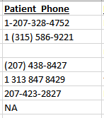
Clean up phone numbers
What do our phone numbers look like?
Some have leading Country code
Some have parentheses
Some have dashes
Some are missing or NA
There are many ways to create a cleaner phone number column, but we will look at some uses of strapply() and gsub() to do this.
Things to learn:
strapply() without specifying a function
strapply() with specifying a function
strapply() control of the output format
gsub() to replace text
strapply():
https://cran.r-project.org/web/packages/gsubfn/gsubfn.pdf
https://www.rdocumentation.org/packages/gsubfn/versions/0.7/topics/strapply
gsub():
https://www.rdocumentation.org/packages/base/versions/3.6.2/topics/grep

Slide 36
Clean up phone numbers
The patterns we will use for this section:
"^(\\d\\D{1,2})?(.?\\d{3})\\D{1,2}(\\d{3})\\D(\\d{4})“
^ anchors the beginning of the pattern. Nothing can come before our pattern in any string that matches.
\\d stands for a digit (0-9)
\\D stands for NON-digit (not 0-9)
{1,2} indicates the number of times the previous thing or group can occur
? says “maybe present”
. stands for any character except newline
() parentheses create capture groups – in this case one for each section of the phone number
(country code) – (area code) – (prefix) – (line number)
Notice that the first \\D{1,2} is contained within the parentheses, and the others are between. Why?
The entire first part of the pattern up until the area code needs to be optional
“\\D”
one NON-digit
“\\d.+”
a digit, followed by any character except newline at least one time
+ says “at least once”

Slide 37
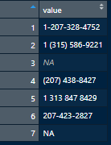
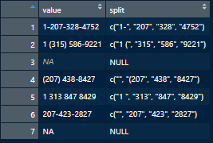
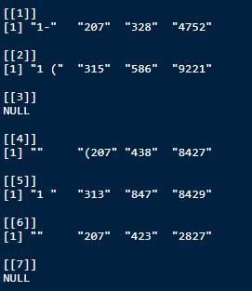
Clean up phone numbers
Grab our phone numbers to work with them separately in their own tibble:
Set up our 1st pattern and use strapply() to capture the groups and make a new column
Each row now contains a character vector of the 4 groups →
Note the optional 1st group - which accounts for possible
leading country code text
Result is a list of character vectors, each one split phone number
The returned items are only what matched inside our capture groups!
anything matched to the pattern in between the groups is not returned (space, dash, etc)
You will see other punctuation with the country code group – remember how we included it all inside the 1st capture group?)
Use the c option to concatentate the result into one vector for each input value, and include all captured groups in one variable
The same code when not made into a column returns a list of character vectors →
This list is the same length as the input data.

Slide 38
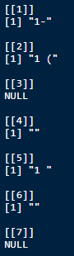
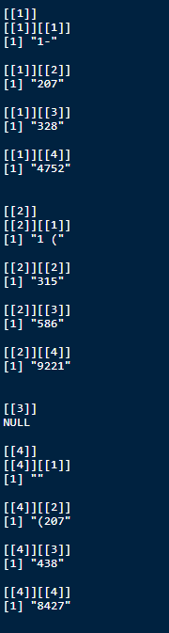
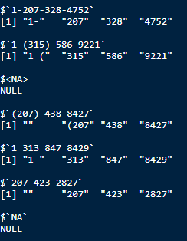
Clean up phone numbers
What if?
What happens if we don't use "c"?
only gives the first group
What happens if we make each result a list?
gives nested lists of characters within a list
What happens if we show the names?
Names each vector in the list: shows what each result came from. Names can be called up later using $

Slide 39
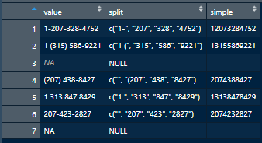
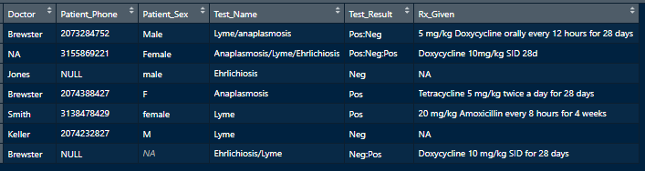
Clean up phone numbers
Now we have the new column with split phone numbers, what next?
Wrap the split phone number in unlist() to unlist them, and remove all but the digits using gsub()
This gives us one character vector, which we make into a new column
Notice there are only digits, and no other characters. And each row has one string.
Finally, if there is a leading country code, remove it
Apply the function to all rows with digits in them (not NA or empty or text)
Wrap in paste() to get a nice character vector (not a list)
paste( strapply(data, pattern, function) )
This gives a character vector, which we set as a column. Notice there are no leading country codes
Last step is to set our new cleaned column
as the phone number column in the original data
(replace the old one):

Slide 40
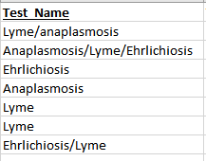
Add a column to flag Lyme testing
What do our test names look like?
Each patient row has one field containing all test names
Separated by “/”
Sometimes not capitalized
Let’s create a new column with a flag for any Lyme testing performed. We can use grepl() to get a vector of TRUE/FALSE matches to a pattern.
Things to learn:
grepl() within dplyr::mutate()
grepl() directly used as a TRUE/FALSE vector
grepl() within ifelse()
grepl(): https://www.rdocumentation.org/packages/base/versions/3.6.2/topics/grep

Slide 41
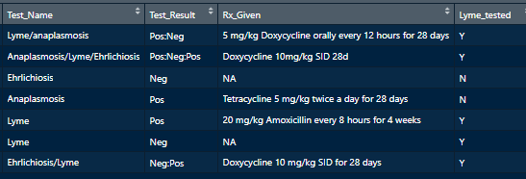
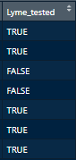
Add a column to flag Lyme testing
grepl() will give us a logical vector, the same length as our input Test_Name field.
This can be used in a few ways:
With dplyr’s mutate() we can make a new column
Apply the TRUE/FALSE vector directly as a column
Use ifelse() and have grepl() be the test when making a new column

Slide 42
Add a column to flag Anaplasmosis testing
What do our test names look like?
Each patient row has one field containing all test names
Separated by “/”
Sometimes not capitalized
Let’s create a new column with a flag for any Lyme testing performed. We can use str_detect() to get a vector of TRUE/FALSE matches to a pattern.
Things to learn:
str_detect() output can be used the same way as grepl() output
negate option gives the inverse result
str_detect is similar to grepl() https://stringr.tidyverse.org/reference/str_detect.html

Slide 43
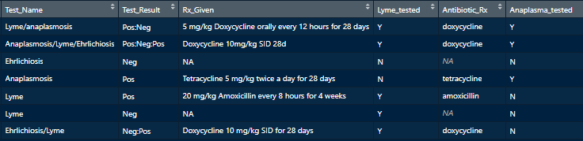
Add a column to flag Anaplasmosis testing
str_detect() will give us a logical vector, the same length as our input Test_Name field.
Make a new column by using this vector any of the ways we did with grepl()
FUN FACT: Using the negate = TRUE option will give the exact opposite results
(TRUE result with negate means NOT MATCHED)
* This could be useful if you wanted to make a subset of non-matches

Slide 44
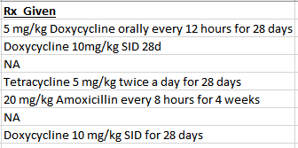
Add a column with the name of any select antibiotics that were prescribed
What does our prescription field look like?
Free text
Rx instructions with dosing
Let’s use str_match() to pull out only the antibiotic names, and save them to a field which can later be used for summary tables or graphs.
Things to learn:
str_match() output format and what each column can be used for
How to call up specific str_match() output
str_match(): https://www.rdocumentation.org/packages/stringr/versions/1.4.0/topics/str_match

Slide 45
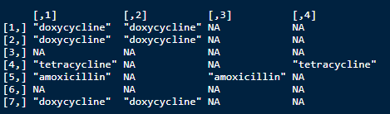
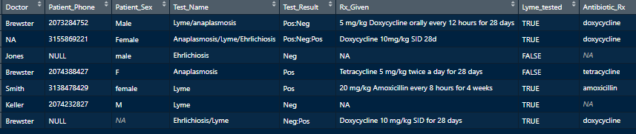
Add a column with the name of any select antibiotics that were prescribed
The result of str_match() is a character matrix of ONLY the matched part of the full text.
use the tolower() wrapper as we would "ignore.case“ for grep() or grepl(), making our input data all lowercase.
First column is the complete match, followed by one column for each capture group.
To access a specific column and use it, make use of the [row,column] index format.
In our case, to use the complete matches(column 1) we can add it as a column to our full data:

Slide 46
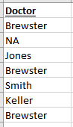
Create a subset for a certain doctor
What does the Doctor field look like?
Last name only
Fairly clean
We can use grep() to get the indices of rows matching Dr. Brewster, and create a subset for his cases.
Things to learn:
grep() only returns the matched indices – the result length can vary
Use the resulting indices to subset a dataframe
grep(): https://www.rdocumentation.org/packages/base/versions/3.6.2/topics/grep

Slide 47
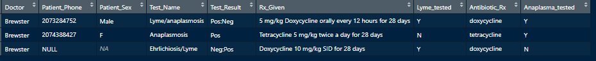
Create a subset for a certain doctor
grep() returns a vector containing the selected elements of the data
Only returns the index of each match – not same length as the input data
Use these row indices to subset the dataframe using the [row,column] format

Slide 48
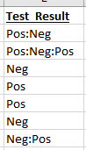
Make a clean table of patient test results
How are the test results provided?
The patient test names and results are provided as one long string in each row
Separated by a colon
Pos/Neg are the options
We can use str_split() to split the fields into individual tests, and then create a cleaned up table of a patient’s test history.
Things to learn:
str_split() output as default
str_split() output using simplify = TRUE
str_split(): https://www.rdocumentation.org/packages/stringr/versions/1.4.0/topics/str_split

Slide 49
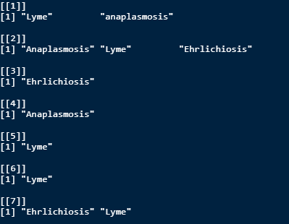
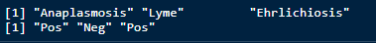
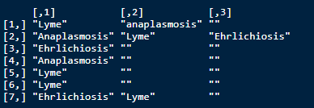
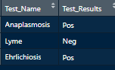
Make a clean table of patient test results
str_split() returns a character vector, character matrix, or list of character vectors
Running str_split() over every row of a field will give us back a list of character vectors.
Using the simplify = TRUE option will make this a nice character matrix
Using str_split() for only one row (patient) will give us a list of length one of one character vector for each field, which can then be bound together into a table report for that patient.
Use the index of this one listed element to save it: [[1]]
To use simplify = TRUE, you would index using [1,] for the row number you are calling

Slide 50
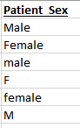
Clean up the gender column
What does the gender field look like?
Some empty
Some full words, others just a letter
Capitalization varies
For ease of grouping and making summaries/graphs in the future, we want to make sure patient sex is always recorded in the same format.
We can use gsub() again to replace any unwanted formats
Remember, gsub lets you specify replacement text, and it is placed anywhere the match was found

Slide 51
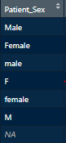
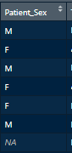
Clean up the gender column
We start with this:
Replace anything not in “M” or “F” format:
Note the anchor before “male”, so that the latter half of “female” is not matched.
Note that the parentheses make a capture group for the latter part of the words, allowing for the ? to make them optional.
The “m” and “f” only appear in the pattern once, even though they are used to match both a single letter or full word.

Slide 52
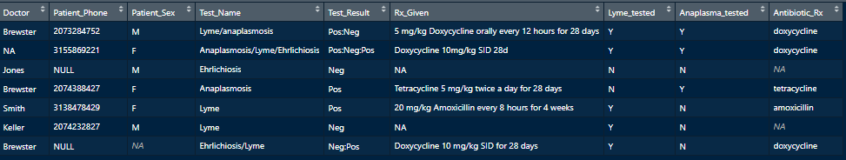
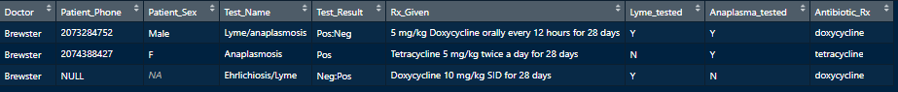
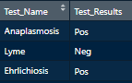
Review the results
After making use of REGEX, we have:
Cleaned up our main dataframe – phone numbers, gender, new columns
Made a subset for Dr. Brewster
Made a test report for patient 2

Slide 53



Questions?

Slide 54

Try it on your own!
Go through the code on your own time
Make sure you understand what is happening
Add some small changes, or alter the options to see how it affects the output
Read the documentation to see other ways to use the commands
Think of other things you might want to do with this dataset
Make your own patterns and play around with some of the functions
Send me any questions
Have fun!

